Slide 1

RPM
A GUARANTEED PATH TO PROFIT

Slide 2
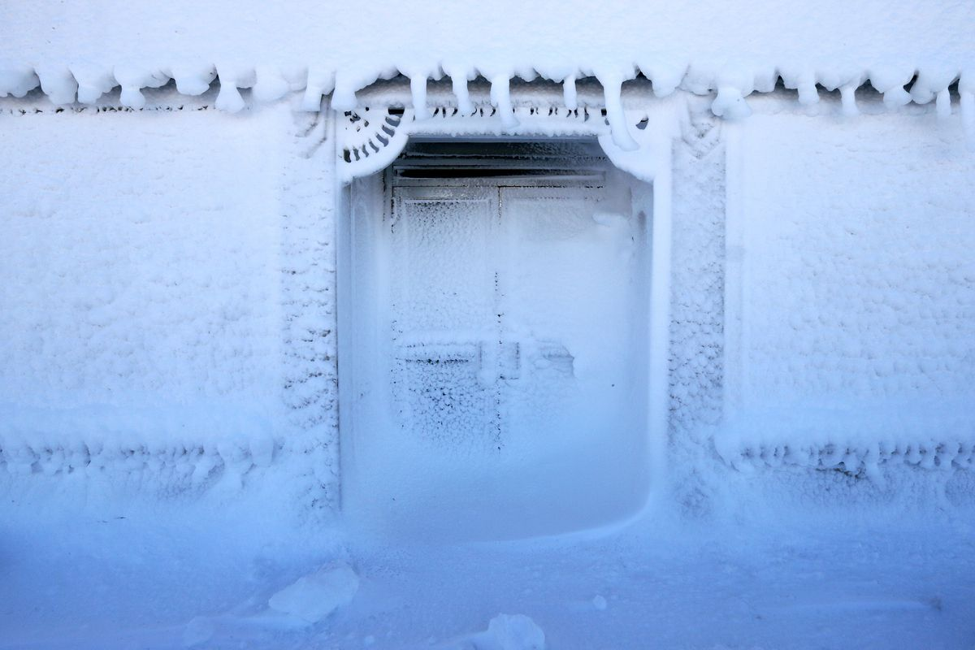
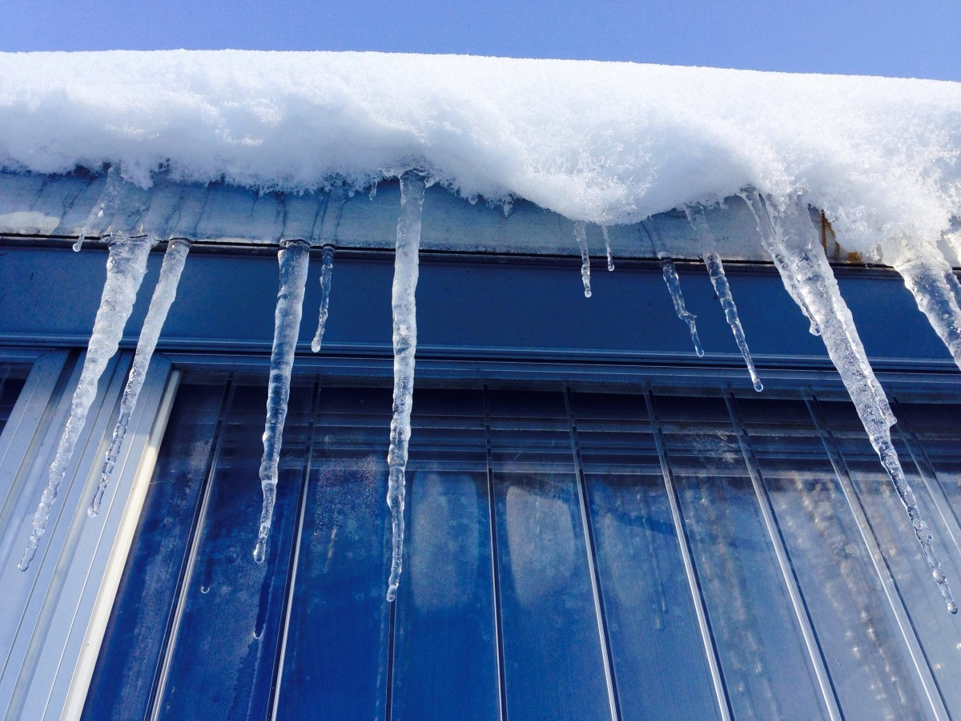
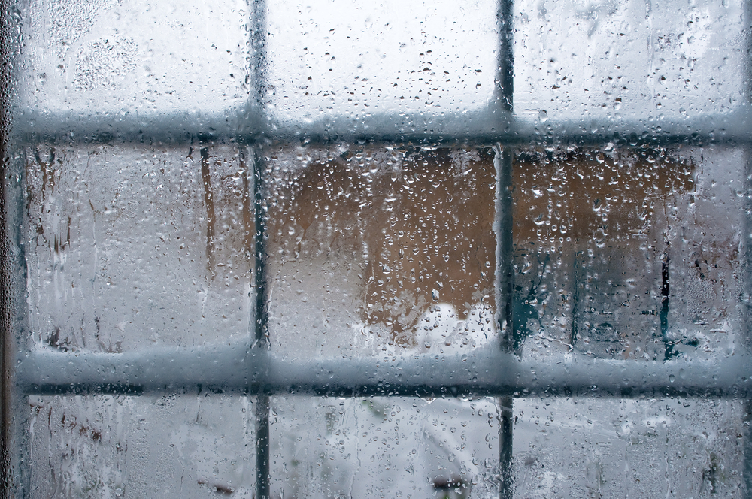
RPM…SORRY NOT TODAY!
Winter woes…AH BUT WAIT!
The Winter hack…
for Unelko RPM water-based products to help battle the cold weather freezing…
As a real-world notation, some defined limitations…below 32° it starts to become more challenging and as you approach the 20°s and lower the answer is sorry, not today.

Slide 3
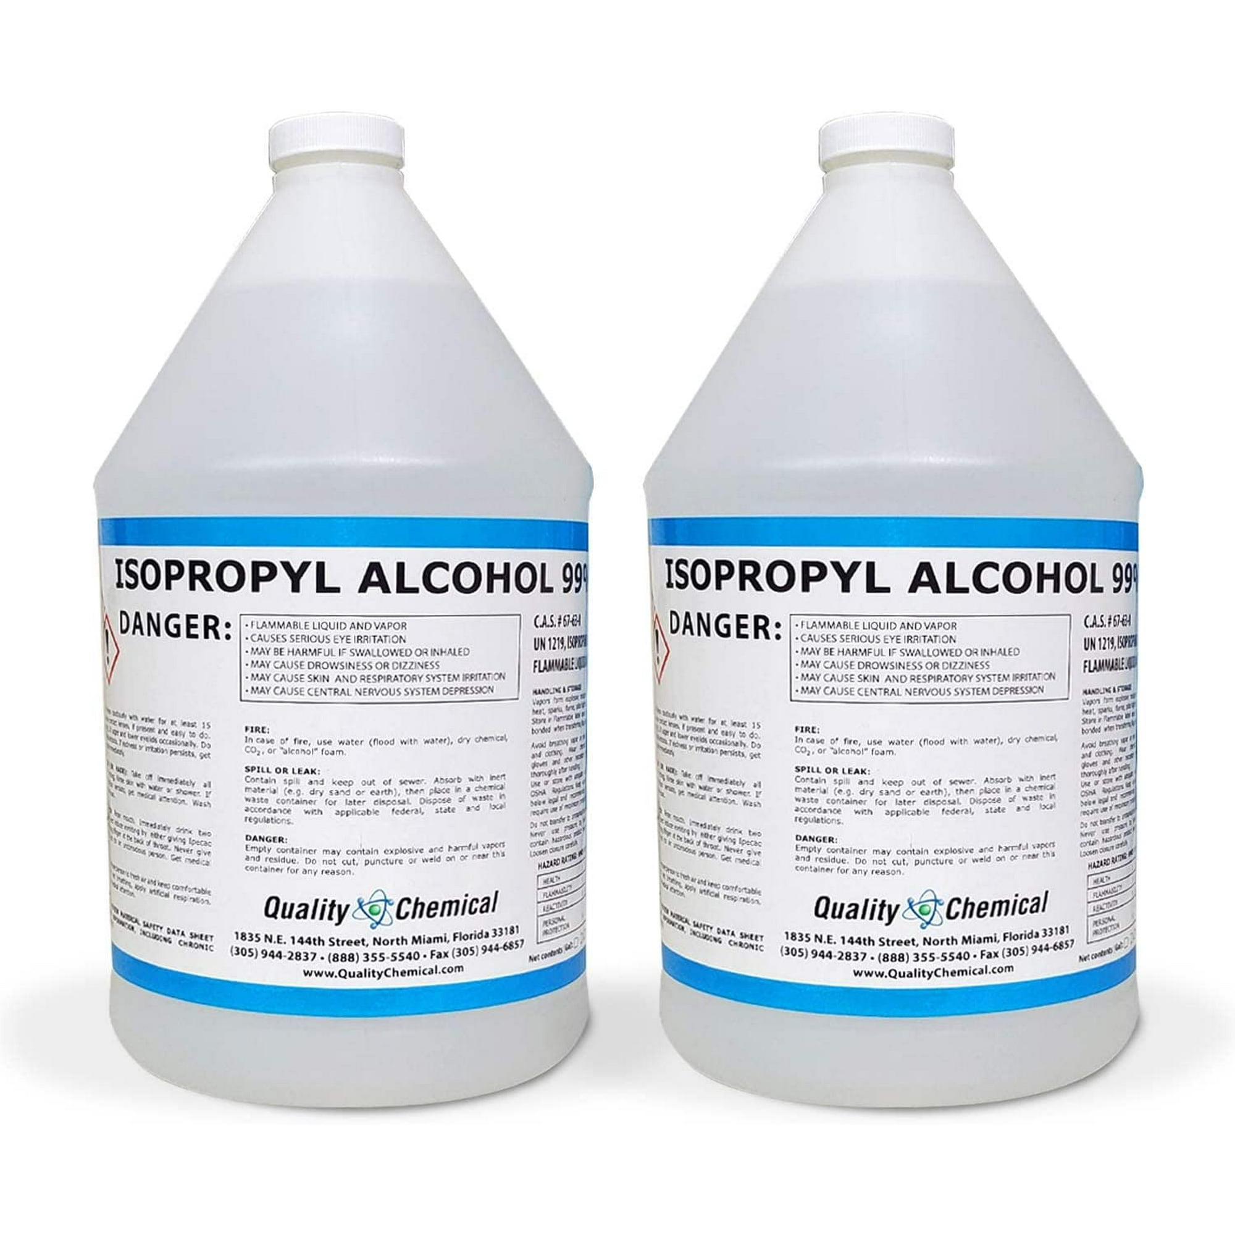
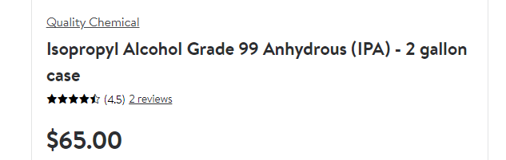
The Winter hack…
Add 3% to 8% alcohol to
REPEL, Limescale Remover and even the PreCleaner
NOTE: Example: 32oz. add 2 to 3 ounces of Isopropyl alcohol
IMPORTANT NOTE: PRO15 is alcohol based.
IT WILL NOT FREEZE AND SHOULD NOT BE MODIFIED
Below is only a reference for an alcohol option…
Available through Walmart

